Slide 1
Live coding session
We are coding a pokedex
and getting our datas from an API
Repo: https://github.com/AnnoDomine/HackschoolViteBoilerplate

Slide 2
Introduction
Dominic Seel
38 yo
Trained retail salesman
Coding since 2001
Dez 2022 – Feb 2023 internship
Since Feb 2023 Software engineer
Love coding, video games and my wife

Slide 3
What you see today
React in a nutshell
Introduction in fork and clone a github-repository
Installing packages with npm
Typescript is more than awesome
Write the first code (Button)
Getting informations from an API
Save the response to a global state managment
Work with the response
Bundling and publish

Slide 4
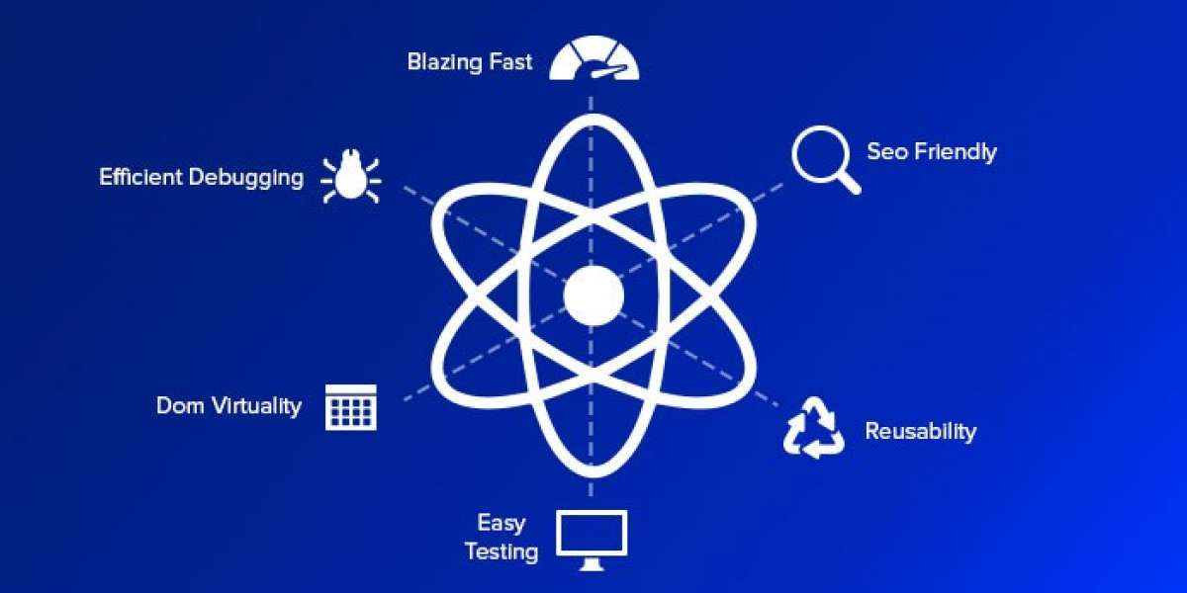
React with react

Slide 5













React and the posibilities
Millions of libraries
Special libraries only for react applications
A huge and awsm community
The most used application library based on node.js
React is not a framework

